Slide 1
Back to School Night 2015-2016
Third Grade Presentation

Slide 2
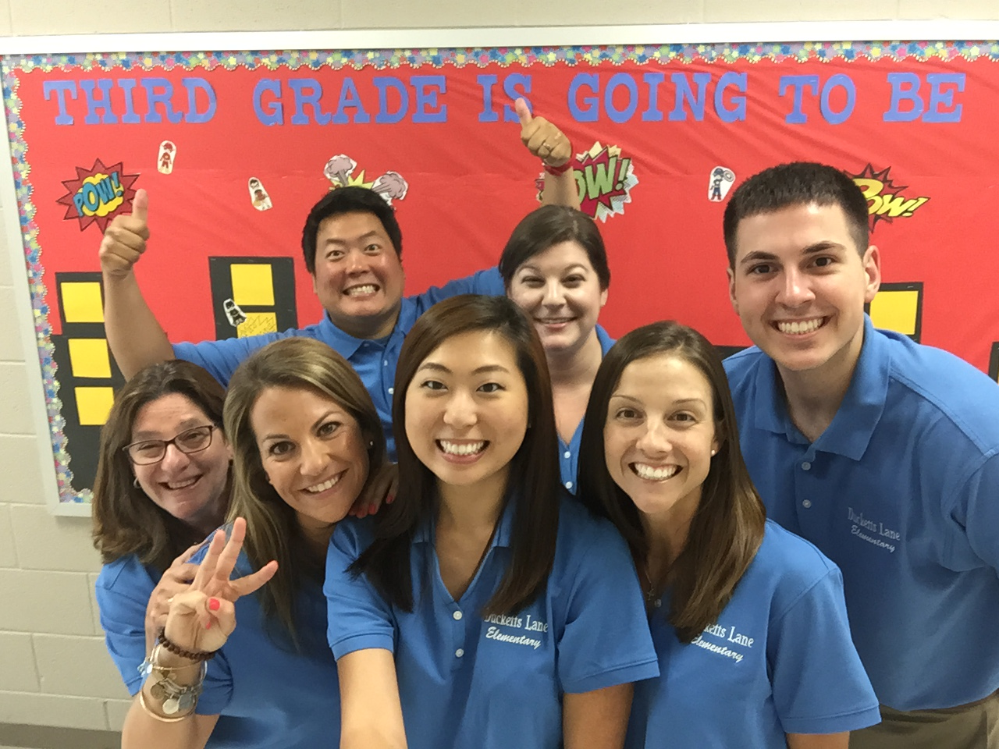
3rd Grade Teachers
Mrs. McWilliams (ITL)
Ms. Lawn
Ms. Cho
Mr. Sporgitas
Ms. Abelman
Mr. Bredland
Mrs. Lerman (paraeducator)
Mrs. Tracy (Special Educator)
Mrs. McClelland (Special Ed Para)
Mrs. Kauffman (ESOL Teacher)
Mrs. Hopkins (Reading Specialist)

Slide 3
Questions/Answers Tonight is a Visitation Night
Your name & Child’s name
Questions

Slide 4
3rd Grade Schedule
Related Arts schedule is departmentalized by subject.
Homeroom Language Arts class at 1:00-1:45.
Homeroom Math class at 2:30-3:15
Monday | Tuesday | Wednesdsay | Thursday | Friday
Art | P.E. | Music | P.E. | Media

Slide 5
HCPSS Connect
Family File: Complete emergency contact forms

Slide 6
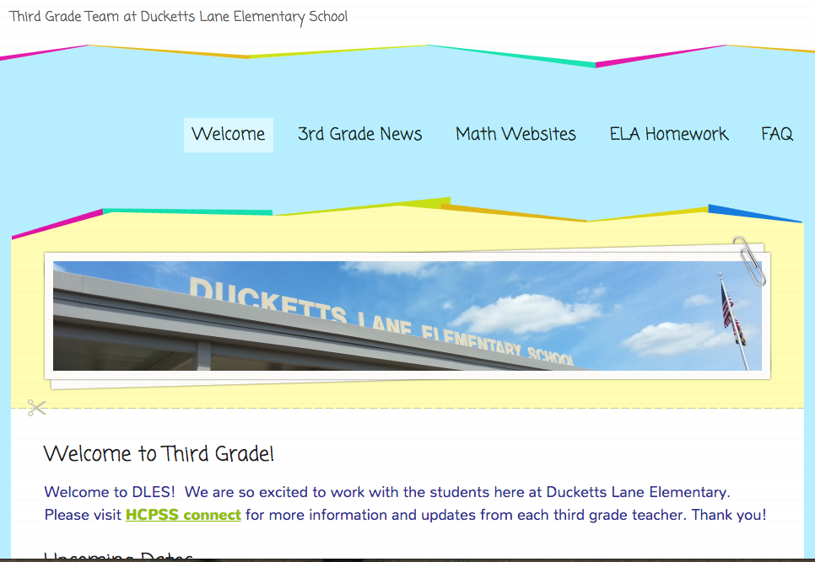
Class Website
www.dles3rdgrade.weebly.com

Slide 7
Remind 101
Remind 101 is a messaging tool to provide communication between the teachers and students.
Your phone number will not be displayed.
Teachers will send out information on homework, fieldtrips, special days, announcements, etc. Also, look on HCPSS Connect for more information and announcements.

Slide 8
Lunch and Recess
Lunch costs $2.75
Milk costs $0.50
Breakfast $2.00
Students order lunch daily from Mrs. Lerman in the morning.
Students who forget their money or forget to bring their lunch from home can borrow money from the school. Your child will receive a slip in their agenda book as a reminder to pay for lunch the following day.

Slide 9
Snack
Students will be allowed to buy snack on a weekly basis
Monday - Cho
Tuesday - Abelman
Wednesday - Lawn
Thursday - McWilliams
Friday - Sporgitas
$0.75
Fruit Ices, Pretzel, Water, and Cheese

Slide 10
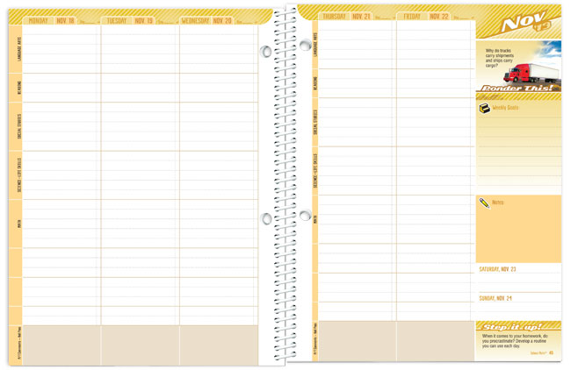
Agenda Book
Homework
Form of communication.

Slide 11
Homework Policy
All homework should be returned by the assigned date. Assignments not turned in on time will not receive full credit. Homework is assigned on a daily basis. Please send a note for circumstances regarding homework completion.
Students who are absent should see the teacher for each subject immediately. Students will be given same amount of days as they were absent to complete any make up work.
Students can collect any make up work from their teacher after their absence from school.

Slide 12
Thursday Folders
These will be used as a weekly communication between home and school.
The folders will be sent home on Thursday and should be returned on Friday.

Slide 13
Grading
Our 3rd grade students will now receive letter grades for the first time. Students will receive grades in the following areas:
Math (Concepts & Problem Solving)
Reading
Writing
Language Mechanics
Spelling
Science
Social Studies
Health
Related Arts (P.E., Art, Music, Media, Technology)

Slide 14
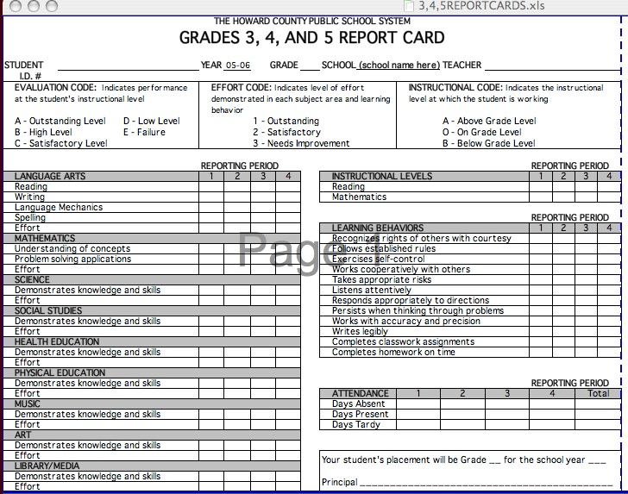

Slide 15
Grading
All grades will be a combination of class work, homework, and assessments. All third grade teachers will use the following grading scale:
90-100% = A (Outstanding)
80-89% = B (High Level)
70-79% = C (Satisfactory Level)
60-69% = D (Low Level)
50-59% = E (Failure)
Star/stamps = completion grade
Number (18/20) = graded

Slide 16
How Students will be Assessed
Teacher observation
Participation/Discussion
Writing Journals
In-class independent & group work
Quizzes/Tests
Homework

Slide 17
What is PBIS?
Research and data-driven based behavioral interventions
Consistent expectations, language and implementation throughout the building
Effective discipline = maximized learning

Slide 18
PBIS at Ducketts Lane
Positive Behavior Support is a process for teaching children appropriate behavior and providing the supports necessary to sustain that behavior.
PBIS is not a curriculum, it is a framework for systems to identify needs, develop strategies, and evaluate practice toward success.
The expectations at Ducketts Lane are:
Respectful
Responsible
Ready
Students’ positive behavior is rewarded with Owl Feathers and they can trade in for a reward in the morning or at the end of the class period.

Slide 19
PBIS
Character Traits Lessons in the classrooms every month
PBIS Theme: STRENGTHS
Achieving Discoverer
Competitor Future thinker
Dependability Organizer
Caring Presence
Confidence Relating

Slide 20
Class Dojo
Positive reinforcement strategy.
Students given points for positive behaviors.
Parents can sign up and link to their child’s progress.

Slide 21
1-2-3 Magic
1-2-3 Magic is a warning system which provides the student to independently monitor their behavior when given a verbal reminder.
After the teacher counts to three, the student is asked to take a break to think about their action and then return to the group shortly after.

Slide 22
Reading
We will be using a combination of trade books, The Treasurer series, novels, and magazines to provide instruction at your child’s level.
Students are placed in flexible reading groups to match their instructional level.

Slide 23
Writing
Your child will practice writing for many different purposes including:
Narrative writing
Informative writing
Opinion writing
Your child will write in a variety of formats, such as stories, letters, poems, and reports.
We will also work on cursive writing throughout the year.

Slide 24
Social Studies
Unit I: Changing Communities
Unit II: Mapping our World
Unit III: Money Matters
Unit IV: The Citizen and the Community
Social Studies lessons will be presented through interactive activities that include role-playing, creating products and in-depth discussions.

Slide 25
WORD STUDY
A Powerful New Approach
Phonics
Prefixes
Suffixes
Vocabulary
Greek & Latin Roots
Spelling
Notes:
Howard County is very excited to announce a system-wide initiative in which all students in grades 1-5 will focus on Greek and Latin roots as they are outlined in our new Maryland College and Careeer Ready Standards. A program called Buildiing Vocabulary has been purchased for every classroom teacher. The purpose of this part of our program is to acquaint you with the rationale and implementation of this new approach to word study.

Slide 26
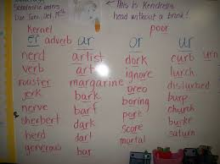
Word Study
NOW
Word lists are organized through meaningful roots or patterns
Expand and deepen word knowledge during content-area study
Applied spelling and language conventions tests
Notes:
NOW
Help students see the meaningful patterns that exist in many words and organize words for study by their roots or patterns. This roots approach to word study is efficient and effective.
. As they explore the topic of the unit, students have multiple opportunities to see new words in meaningful contexts and to use them in meaningful ways.

Slide 27
Nightly Reading Homework
All students are expected to read each night for at least 20 minutes.
Students complete a writing or word study homework every night.
Homework will be checked on Fridays.

Slide 28
New Direction for Standardized Assessments in HCPSS
Measures of Academic Progress (MAP)
Partnership for Assessment of Readiness for College and Careers (PARCC)
Notes:
Better Standards Call for Better Assessments.
Students will be prepared with the skills and knowledge to compete with their peers here at home and around the world.
PARCC and MAP are standardized assessments.
MAP shows individual growth over time in mathematics and reading.

Slide 29
Measures of Academic Progress (MAP)
http://www.nwea.org/products-services/assessments/help-all-kids-learn
Notes:
MAP (Measures of Academic Progress) will be given to all students in grades 1-8 in the 2014-15 school year. This will be our second year using the MAP test.
MAP shows student growth over time in reading and mathematics. It provides students with opportunities to show how they have grown, provides insights into what students are ready to learn, provides an additional measure to support flexible grouping of students and is predictive of how students might do on PARCC assessments. This test is given online at the beginning and end of the school year with an optional opportunity to take a mid-year assessment.

Slide 30
PARCC Assessments
Pathway to college and career readiness
Measures full range of CCSS
Supports educators in the classroom
Makes better use of technology
Advances accountability at all levels
www.parcconline.org/about-parcc
Notes:
PARCC (Partnership for Assessment of Readiness for College and Career) will begin in 2014-15 to assess the standards in the new Common Core State Standards.
In the next two years, all intermediate students will take the PARCC.
PARCC assessments will test writing skills in each assessed grade, as well as critical thinking and problem solving skills. Students will take the new assessments on computers allowing teachers to see test results quickly and adjust classroom instruction to the needs of their students.

Slide 31
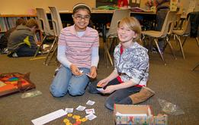
Our New Direction…
Avoiding over-testing by replacing formal local assessments with a menu of tasks that can be used at the discretion of each teacher.
Providing opportunities for students to work with rigorous items.
Supporting students by having data conversations.
Notes:
This summarizes the essence of our new direction for assessment and instruction. (Give participants time to read the 5 bullets.)

Slide 32
3rd Math Homework
Monday morning they will receive a concept review homework. This is a two sided homework and the students will have 2 days to complete it. Due Wed
Wednesday night will be due on Thursday
Thursday night will be due on Friday
No homework on Friday

Slide 33
3rd grade SMART Pages

Slide 34
3rd Grade Math

Slide 35
2015 – 2016
We want to focus on Scientific and Engineering Practices
Asking Questions (for science) and defining problems (for engineering)
Developing and using models
Planning and carrying out investigations
Analyzing and interpreting data
Using mathematics and computational thinking
Constructing explanations (for science) and
designing solutions (for engineering)
Engaging in argument from evidence
Obtaining, evaluating, and communicating information
Notes:
The NGSS aligned curriculum developed by HCPSS was created with the intention to encourage student-centered instruction, with a focus on inquiry. The teacher, acting in the role of facilitator, delivers instruction infused with these 8 Practices so that students may learn not only the content knowledge, but also the behaviors and skills that that lead to success in the science and engineering career fields. In this way, the NGSS aligned curriculum supports HCPSS Vision 2018, by creating an engaging and vibrant learning environment in which every student is inspired to learn and empowered to excel.
A Framework for K-12 Science Education outlines three dimensions to science education:
Scientific and Engineering Practices (behaviors and habits of mind)
Crosscutting Concepts (unifying themes)
Disciplinary Core Ideas (big ideas, or topics)
The three dimensions work together like a braided rope in order to create instruction that is authentic and applicable for students.
The 8 Scientific and Engineering Practices describe the behaviors and habits of mind that are necessary to make students’ knowledge of content (Core Ideas) more meaningful.
The term “practices,” instead of a term such as “skills,” is used to stress that engaging in scientific inquiry and engineering design requires coordination both of knowledge and skill simultaneously.
Acquiring skills in these practices supports a better understanding of how scientific knowledge is produced and how engineering solutions are developed.
Such understanding will help students become more critical consumers of scientific information.

Slide 36
Science
Weather and Climate
Forces and Interactions
Interdependent Relationships in Ecosystems: Plant and Animal Survival
Inheritance and Variation of Traits: Life Cycles and Traits

Slide 37
Health
Social and Emotional Health
Brain Unit
Tobacco, Alcohol and Other Drugs
Safety, First Aid and Injury Prevention
Disease Prevention and Control

Slide 38
Please feel free to donate any of the following:
Tissue boxes
Dry Erase Markers
Glue Sticks
Pencils

Slide 39
Contact Information
Please feel free to e-mail me at veronica_cho@hcpss.org
410-313-5050
Best time to call:
Before school 8:00-8:30
Tuesdays-Fridays 1:00-1:40

Slide 40
2015-2016
Thank you for joining our partnership at Ducketts Lane!
Please sign up for the PTA.
We look forward to a great year!

